Slide 1
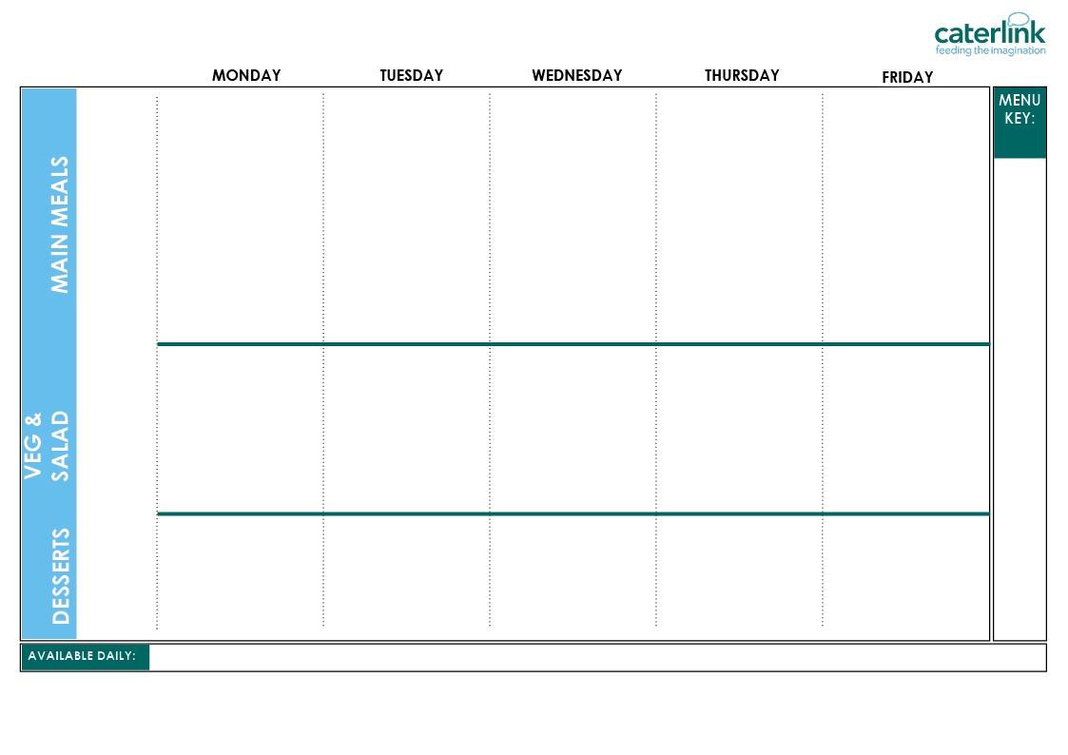




WEEK 1 CAMDEN AUTUMN WINTER MENU 2026/27
Planet Friendly Day
Option One
2/11/26
23/11/26
14/12/26
4/1/27
25/1/27
22/2/27
15/3/27
Option Two
Vegetables
Dessert
Lentil and Roasted Vegetable Wholemeal Pasta (VE) | World Explorer Chickpea and Spinach Curry with Rice (VE) | V Lentil and Mushroom Wellington with Roast Potatoes and Gravy (VE) | Tomato and Herb Bolognaise with Spaghetti (VE) | Red Pepper Frittata with Chips & Tomato Sauce (V)
Planet Friendly Balls in Tomato Sauce with Rice (VE) | Beef Bolognaise with Spaghetti | Roast Chicken, Stuffing, Roast Potatoes and Gravy | Chicken Tikka with Rice | Breaded Fish with Chips / Potato Wedges & Tomato Sauce
Broccoli (VE) Carrots (VE) | Green Beans (VE) Cauliflower (VE) | Peas (VE) Red Cabbage (VE) | Butternut Squash (VE) Roasted Peppers (VE) | Peas (VE) Sweetcorn (VE)
Rainbow Slaw (VE) Sweetcorn (VE) Diced Cucumber (VE) Crispy lettuce (VE) Couscous Salad(VE) | Lettuce (VE) Pepper Sticks (VE) Pasta Salad (VE) Grated Carrot (VE) Greek Salad (VE) | Roasted Sweet Potato (VE) Carrot Sticks (VE) Cucumber (VE) Diced Peppers(VE) Coleslaw (V) | Sweetcorn (VE) Tomatoes (VE) Lettuce (VE) Cucumber (VE) Carrot Sticks (VE) | Beetroot and Orange Salad (VE) Tomato Pasta (VE) Lettuce (VE) Tomatoes (VE)
Yoghurt & Tinned Peaches (V) | Apple Crumb Cake with Custard (V) | Yoghurt & Fresh Fruit (V) | Jelly and Manderins (V) | Yoghurt & Tinned Peaches (V)
Whole
grain
Plant-based and Planet Friendly
Added plant protein
Chef’s Special
Local
Red Tractor
Meat
Local, Seasonal Fruit & Veg
Freshly cooked jacket potatoes with a choice of fillings (V/VE) - A choice of flavoured breads freshly baked on site daily (VE) - Daily salad selection (V/VE) – Fresh Fruit (VE) – Natural Yoghurt (V/VE) - Drinking Milk (V/VE)
(V) Vegetarian (VE) Plant-based and Planet Friendly
If you would like to know about particular allergens in foods, please ask a member of the catering team for information. If your child has a school lunch and has a food allergy or intolerance you will be asked to complete a form to ensure we have the necessary information to cater for your child. We use a large variety of ingredients in the preparation of our meals and due to the nature of our kitchens it is not possible to completely remove the risk of allergen cross contact.

Slide 2
WEEK 2 CAMDEN AUTUMN WINTER MENU 2026/27
Planet Friendly Day
Hearty Cottage Pie (VE) | Chinese Rainbow Noodles (V) | BBQ Quorn with Seasoned Potatoes and Sweetcorn Salsa (VE) | Greek Macaroni Pastitsio (V) | Smashed Bean & Lentil Patty with Chips (VE)
Classic Cheese and Tomato Pizza with Wedges (V) | Chicken and Sweetcorn Meatballs in Tomato Sauce with Rice | Roast Chicken with Seasoned Potatoes and Gravy | Beef Cottage Pie | Fish Fingers/ Salmon with Chips / Potato Wedges & Tomato Sauce
Broccoli (VE) Cauliflower (VE) | Carrots (VE) Sweetcorn (VE) | Green Beans (VE) Peas (VE) | Leeks (VE) Courgettes (VE) | Baked Beans (VE) Peas (VE)
Sweet Potato Power Salad (VE) Mixed Lettuce (VE) Carrot Sticks (VE) Pepper Sticks (VE) Sweetcorn (VE) | Mixed Bean Salad (VE) Coleslaw (V) Green Beans (VE) Diced Pepper (VE) Cucumber (VE) | Beetroot (VE) Rainbow Slaw (VE) Iceberg Lettuce (VE) Tomatoes (VE) Couscous Salad (VE) | Grated Carrot (VE) Cucumber Sticks (VE) Roasted Vegetable and Lentil Salad (VE) Tomato Salsa (VE) Beetroot (VE) | Lettuce (VE) Tomato Pasta (VE) Carrot Sticks (VE) Cucumber Slices (VE)
Yoghurt with Fresh Fruit (V) | Peach Upside Down Cake (V) | Yoghurt with Tinned Peaches (V) | Apple and Strawberry crumble with Custard (V) | Yoghurt and Fresh Fruit (V)
Option One
9/11/26
30/11/26
11/1/27
1/2/27
1/3/27
22/3/27
Option Two
Vegetables
Salad Bar
Dessert
Whole
grain
Plant-based and Planet Friendly
Added plant protein
Chef’s Special
Local
Red Tractor
Meat
Local, Seasonal Fruit & Veg
Freshly cooked jacket potatoes with a choice of fillings (V/VE) - A choice of flavoured breads freshly baked on site daily (VE) - Daily salad selection (V/VE) – Fresh Fruit (VE) – Natural Yoghurt (V/VE) - Drinking Milk (V/VE)
(V) Vegetarian (VE) Plant-based and Planet Friendly
If you would like to know about particular allergens in foods, please ask a member of the catering team for information. If your child has a school lunch and has a food allergy or intolerance you will be asked to complete a form to ensure we have the necessary information to cater for your child. We use a large variety of ingredients in the preparation of our meals and due to the nature of our kitchens it is not possible to completely remove the risk of allergen cross contact.

Slide 3
WEEK 3 CAMDEN AUTUMN WINTER MENU 2026/27
Planet Friendly Day
Option One
16/11/26
7/12/26
18/1/27
2/2/27
8/3/27
Option Two
Vegetables
Salad Bar
Dessert
Saucy Tomato Pasta with Tomato and Herb Bread (V) | Golden Cheese and Bean Pasty with Wedges (V) | Quorn Cumberland Sausage with Roast Potatoes & Gravy (VE) | Mild Mexican Chilli with Rice (VE) | Autumn Pasta Bake (VE)
Macaroni Cheese with Tomato and Herb Bread (V) | Greek Chicken Pitta with Herby Rice and Sweetcorn Salsa | Roast Chicken with Roast Potatoes and Gravy | Beef Mexican Chilli with Rice | Fishfingers with Chips/ Potato Wedges & Tomato Sauce
Baked Beans (VE) Peas (VE) | Sweetcorn (VE) Broccoli (VE) | Green Beans (VE) Cauliflower (VE) | Carrots (VE) Peppers (VE) | Baked Beans (VE) Peas (VE)
Sweet Potato Salad (VE) Carrot Sticks (VE) Diced Pepper (VE) Sweetcorn Salsa (VE) Tomatoes (VE) | Mixed Bean Salad (VE) Beetroot (VE) Iceberg Lettuce (VE) Tomatoes (VE) Couscous Salad (VE) | Apple and Raisin Salad (V) Cucumber Slices (VE) Grated Carrot (VE) Mixed Lettuce (VE) Pepper Sticks (VE) | Tomatoes (VE) Beetroot (VE) Butternut Squash (VE) Mixed Lettuce (VE) Cucumber Sticks (VE) | Rainbow Slaw (VE) Grated Carrot (VE) Green Bean Salad (VE) Vegetable Pasta Salad (VE)
Yoghurt With Tinned fruit (V) | Pear Crumble and Custard (V) | Yoghurt and Fresh Fruit (V) | Yoghurt & Fresh Fruit (V) | Chocolate and Apple Sponge with Chocolate Sauce (V)
Whole
grain
Plant-based and Planet Friendly
Added plant protein
Chef’s Special
Local
Red Tractor
Meat
Local, Seasonal Fruit & Veg
Freshly cooked jacket potatoes with a choice of fillings (V/VE) - A choice of flavoured breads freshly baked on site daily (VE) - Daily salad selection (V/VE) – Fresh Fruit (VE) – Natural Yoghurt (V/VE) - Drinking Milk (V/VE)
(V) Vegetarian (VE) Plant-based and Planet Friendly
If you would like to know about particular allergens in foods, please ask a member of the catering team for information. If your child has a school lunch and has a food allergy or intolerance you will be asked to complete a form to ensure we have the necessary information to cater for your child. We use a large variety of ingredients in the preparation of our meals and due to the nature of our kitchens it is not possible to completely remove the risk of allergen cross contact.

