Slide 1
Knowledge Organiser | Subject: Science | Topic: Am I an animal? | Year 1
Key Knowledge & Vocabulary
There are living things called animals, and humans are animals.
Vertebrates have skeletons inside their bodies. There are 5 main types of vertebrates – birds, fish, amphibians, reptiles and mammals. Invertebrates do not have internal skeletons.
All animals need to eat in order to live. Carnivores only eat meat, herbivores only eat plants and omnivores eat meat and plants.
All animals have offspring, which grow into adult animals. Oviparous animals lay eggs.
Human bodies have different parts and many of these parts help us use our five senses.
Humans need to exercise, eat the right amounts of different food and maintain good hygiene in order to stay healthy.
Working Scientifically
Fair testing
Observing over time
Researching
Classifying, identifying and comparing
Exploring
Seeking patterns
Which did you use in science lessons and why?
Key Concepts
Living things | Animals | Birds | Fish | Amphibians | Reptiles | Mammals | Insects
Living things, including plants and animals, are classified into broad groups based on similarities and differences. | Animals can be classified into two groups - invertebrates (such as insects) and vertebrates (fish, amphibians, reptiles, birds and mammals). | All birds have feathers and wings. Most can fly. All birds lay eggs. They are warm blooded. | Fish don’t have legs and only live in water. They have gills, which allow them to get oxygen from the water – they don’t breathe air. Most fish have scales on their skin. | Amphibians live on land and in water. Most lay eggs in or near water. When they hatch, baby amphibians have gills, but they later develop lungs, to breathe air. | Reptiles have dry, scaly skin. And are cold-blooded. Most reptiles lay eggs, but some give birth to live young. | All mammals have hair and are warm-blooded. All mammals feed their young with milk. They have lungs and breathe air. Almost all mammals give birth to live young. | Insects have six legs and three-part bodies. All have antennae and most have wings. All insects lay eggs.
Linking Thinking Across Our Learning Journey
Nursery | Reception | Year 1 | Year 2 | Year 3 | Year 4 | Year 5 | Year 6
Self-care and healthy bodies | Self-care and healthy bodies | Am I an Animal? | Living things and habitats | Life cycles of plants | Food chains | The Human Body | Evolution and Inheritance

Slide 2
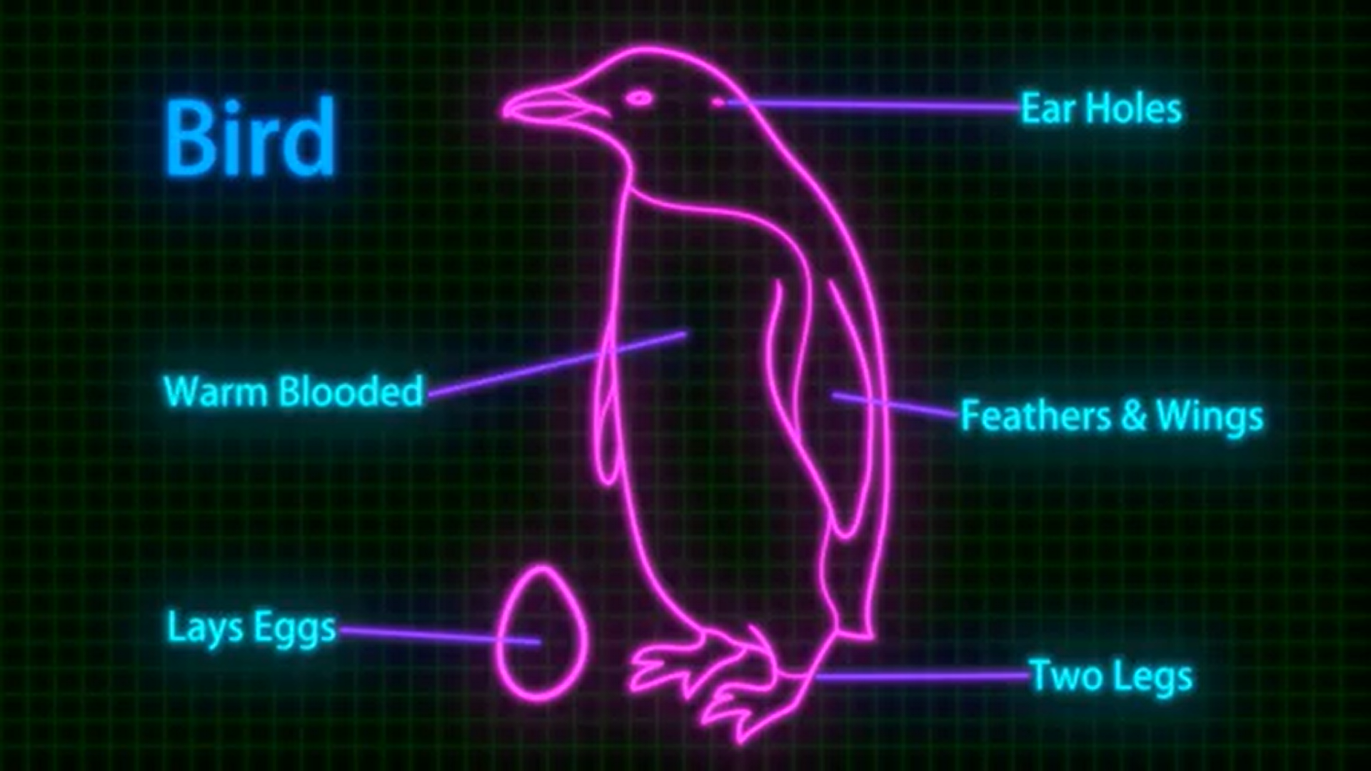
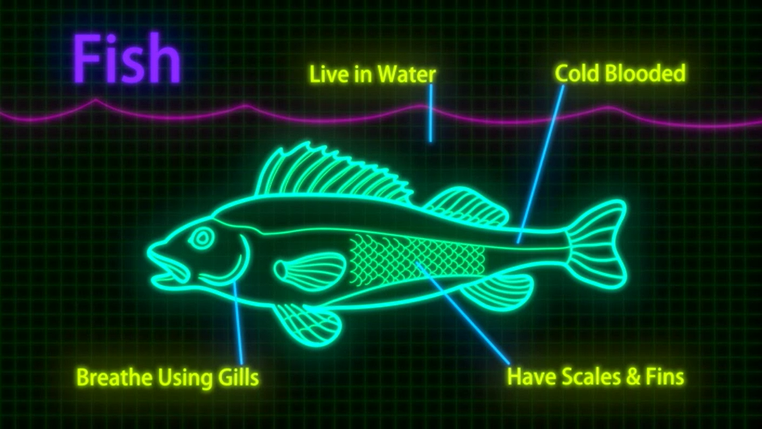
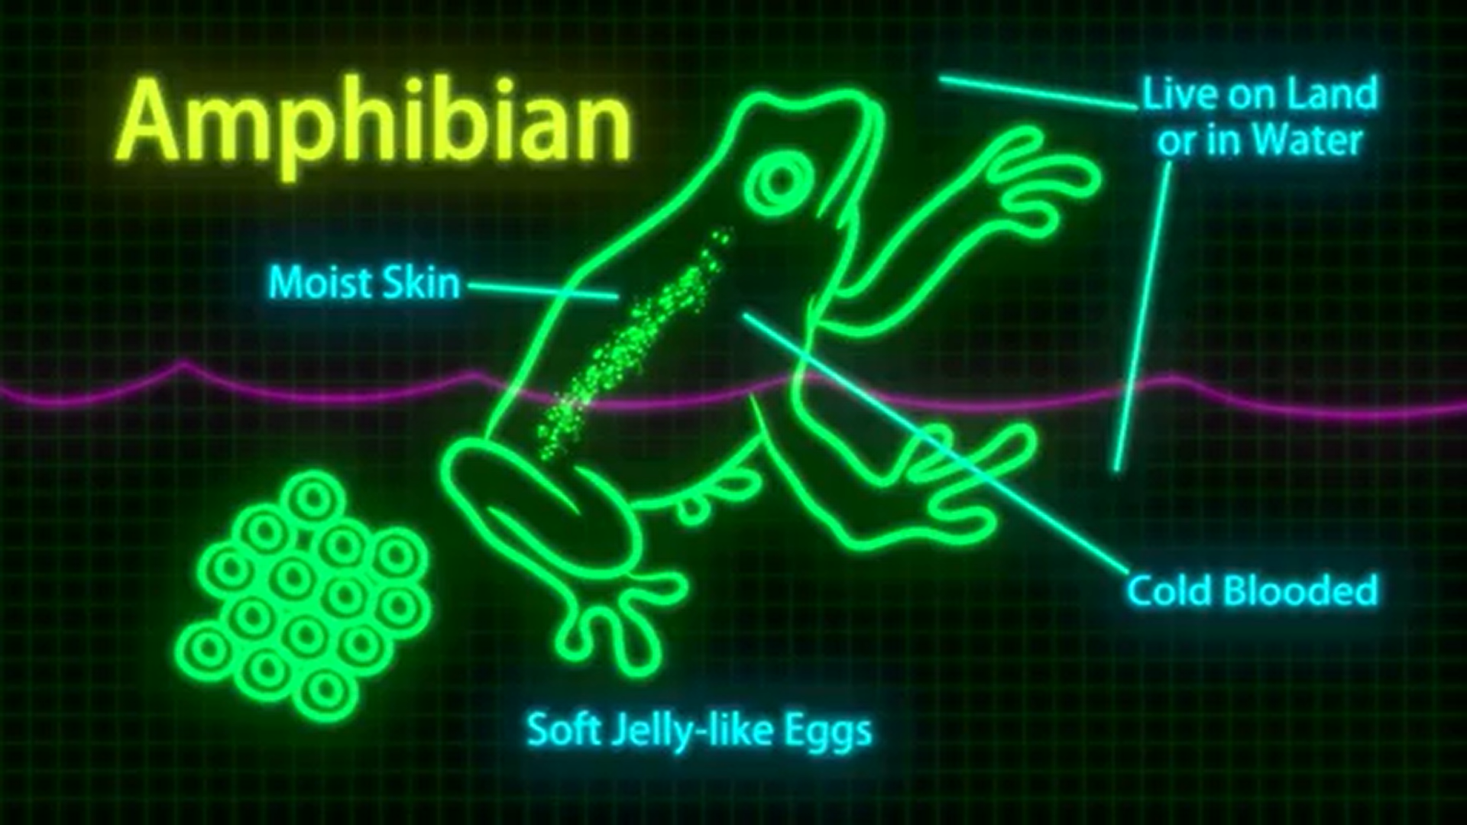
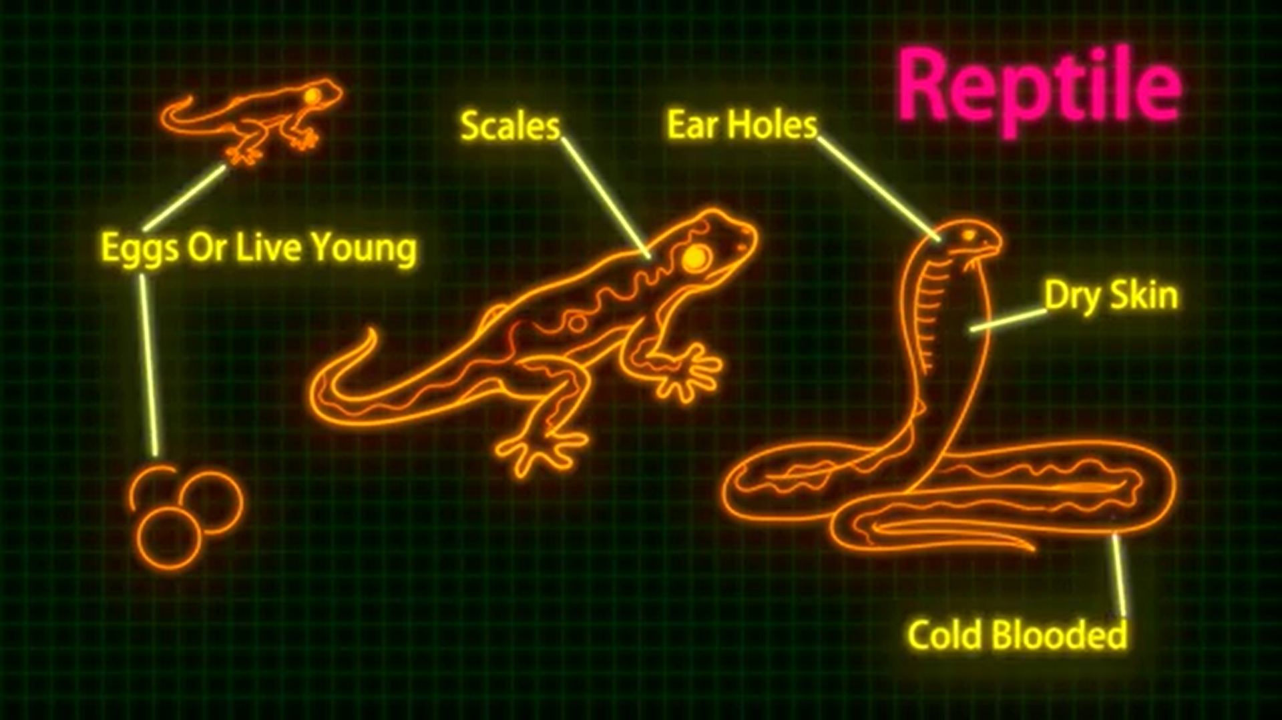
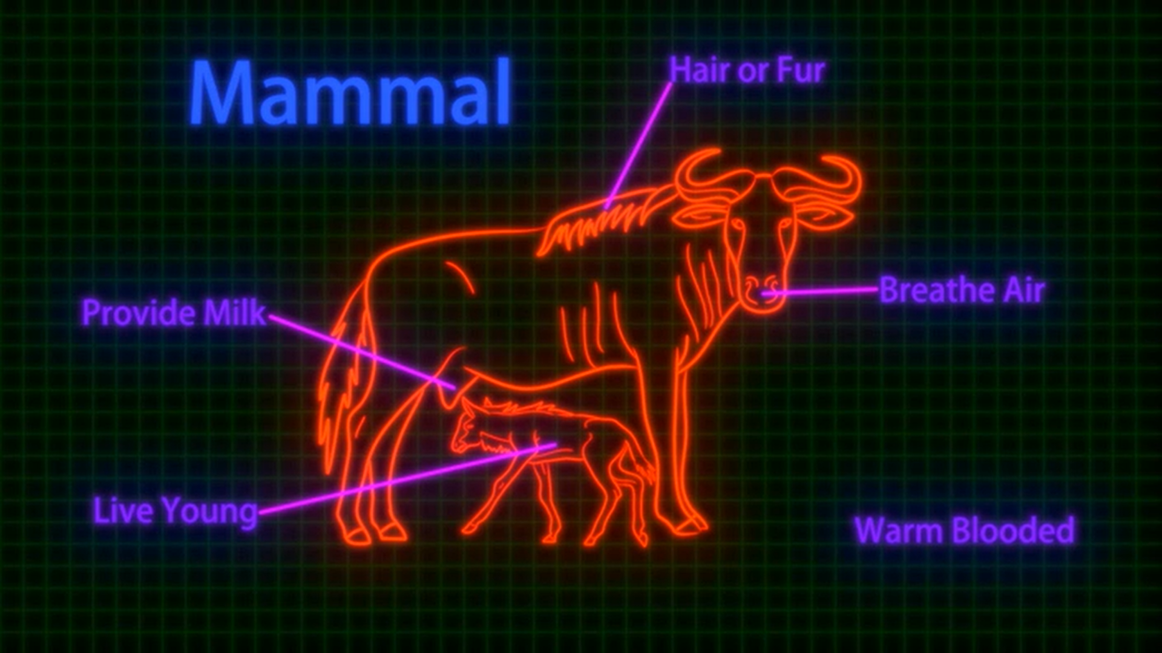
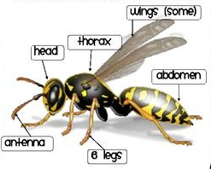
Birds
Fish
Amphibians
Reptiles
Mammals
Insects

