Slide 1
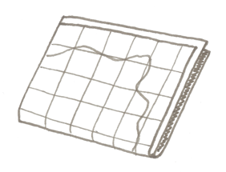
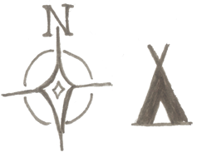
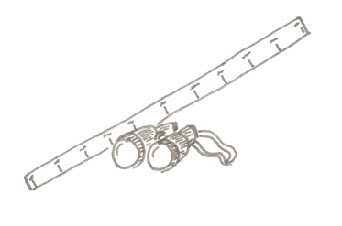
EP Collectable | Subject: Geography | Topic: Natural Disasters | Year 3
Key Knowledge & Vocabulary
To learn the countries of Europe and be able to put them on a map
To be able to plot major volcanoes on a world map
To locate the Ring of Fire and tectonic plates
To name and locate areas that have suffered tsunamis and their location in the world’s oceans
Compare areas which have active, dormant and extinct volcanoes
Being A Geographer
Using maps, atlases, globes and digital software
Using compass directions, grid references, symbols and keys
Using fieldwork to observe, measure, record and present information
Key Concepts
Location Knowledge | Place Knowledge | Human Geography | Physical Geography
Being able to locate countries within Europe, as well as major cities. Identifying the position and significance of the lines of latitude and longitude; the Northern and Southern hemispheres and time zones. | Understanding geographical similarities and differences between places in the UK and around the world. | Things that are made by humans. Considering types of settlement and land use, including how they might differ depending on the landscape. | Things that happen naturally. Describing and understanding key aspects of land including mountains, volcanoes and earthquakes.
Linking Thinking Across Our Learning Journey
Nursery | Reception | Year 1 | Year 2 | Year 3 | Year 4 | Year 5 | Year 6
Early map work placing school in local area | Exploring the streets beyond school | Map work in ‘Our Local Area’ | Map work in ‘Around the World’ | Natural Disasters | Map work for Camping Trip and ‘Survival’ | Locating Rivers and in-depth Amazon study | Human Planet: farming and food miles

Slide 2
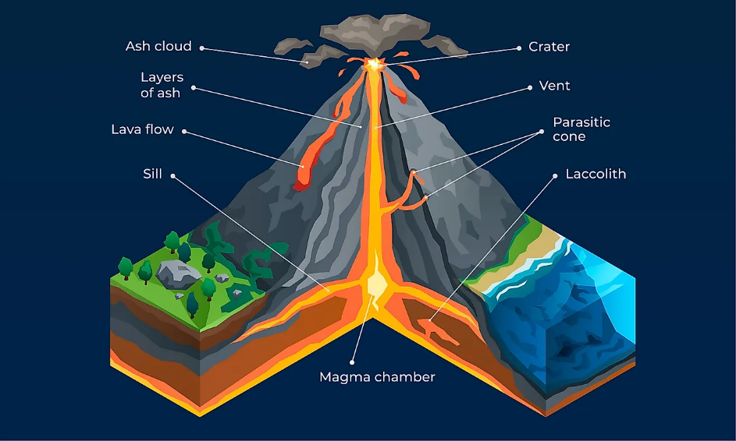
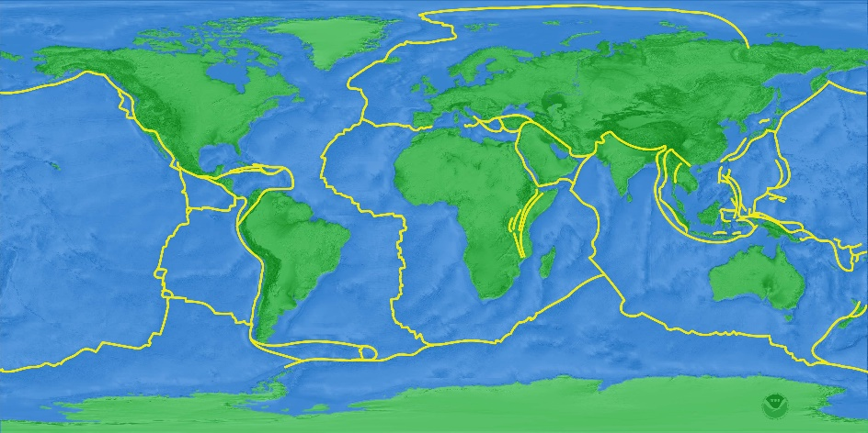
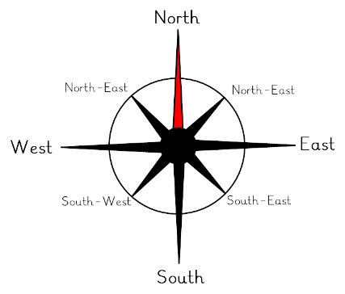
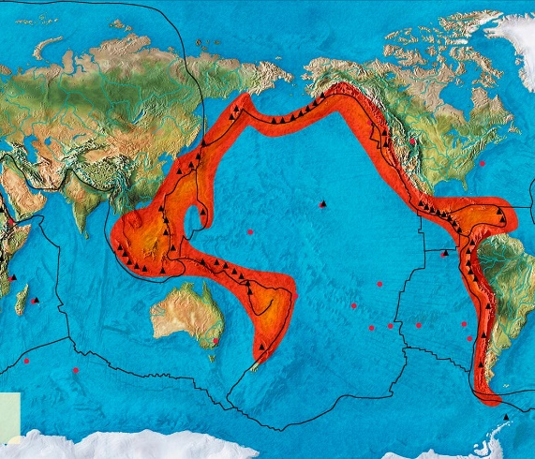
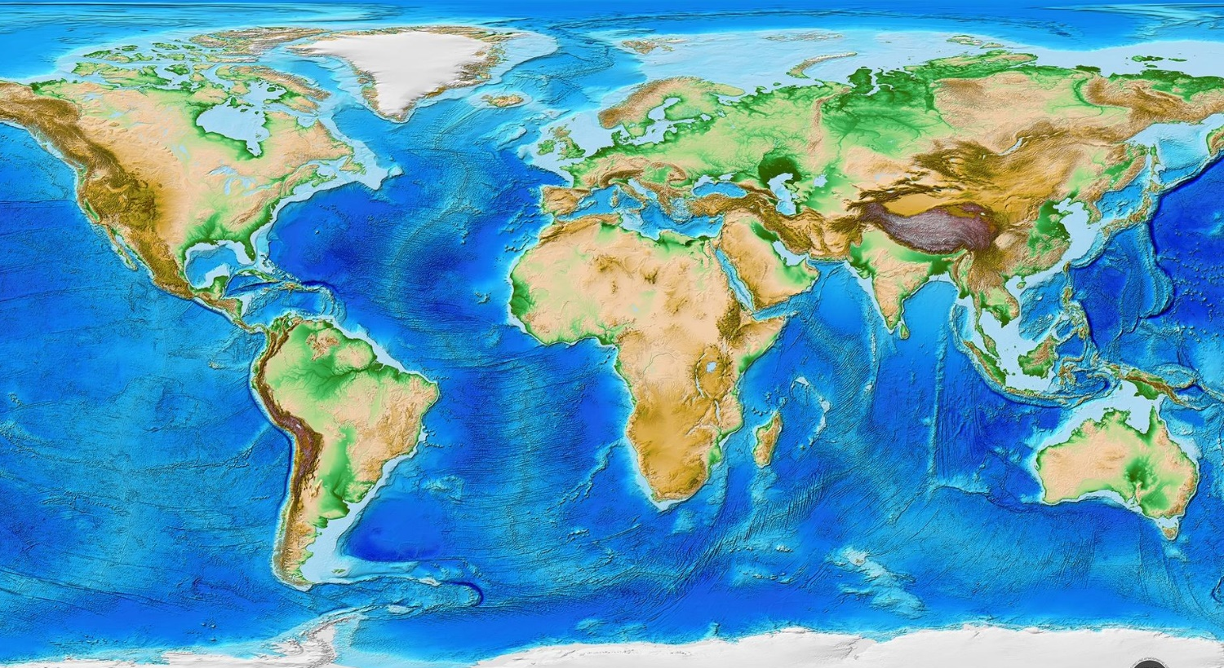
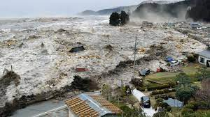
Volcanoes
Tectonic Plates
Compass
Ring of Fire
Tsunami
Mountain Ranges

